Slide 1
신호 최적화 최종발표
ETRI연구연수생 강민수

Slide 2
Contents
Current Model
3x3Grid Single-Agent Model without Restraints(Depreciated)
3x3Grid Decentralized Model without Restraints(Depreciated)
3x3Grid Decentralized Model with Practical Restraints
Dunsan Decentralized Model with Practical Restraints
Dunsan Decentralized CNN Model with Practical Restraints
Upcoming Model
Continuous Action Model with practical restraints

Slide 3
3x3Grid Single-Agent/Decentralized Model without Restraints(Depreciated)
Condition (seed fixed)
Generating probability 0.133 (left, right), 0.388 (up, down)
Restricted direction of vehicles(via)/Not restricted direction(no via)
Central agent(n_1_1), 9 Agents(decentralized)
State
The number of inflow vehicles from each inflow edge(left, straight)
Action
Deciding next phase(without an order), every 20s (with all yellow 3 seconds)
Reward
Penalty on Pressure (= inflow-outflow)

Slide 4
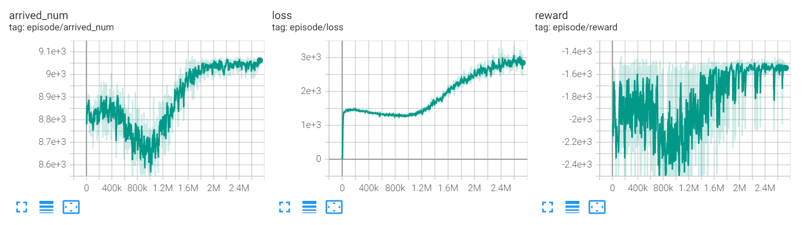
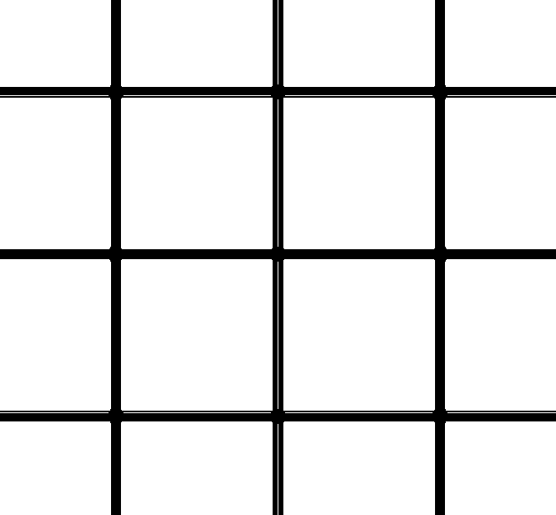
Comparison between Simulation & Single Agent
Simulation 0.133 (left, right), 0.388 (up, down), phase 42(G), 3(Y)
The number of arrived number: 8295 (no via), 8794 (via)
Experiment(Single-Agent Model)
The number of average arrived number: 9060 (no via), 9281 (via)
5~8% Increase
Agent
300m

Slide 5
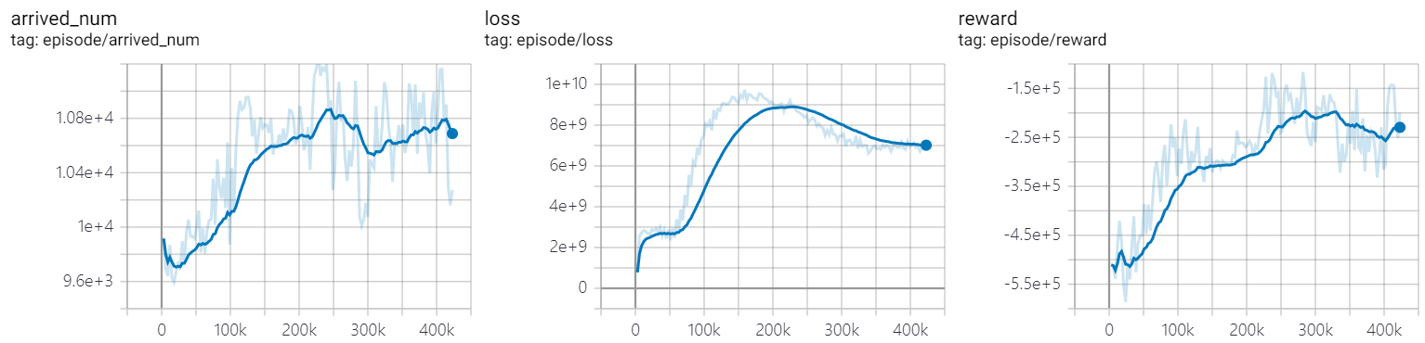
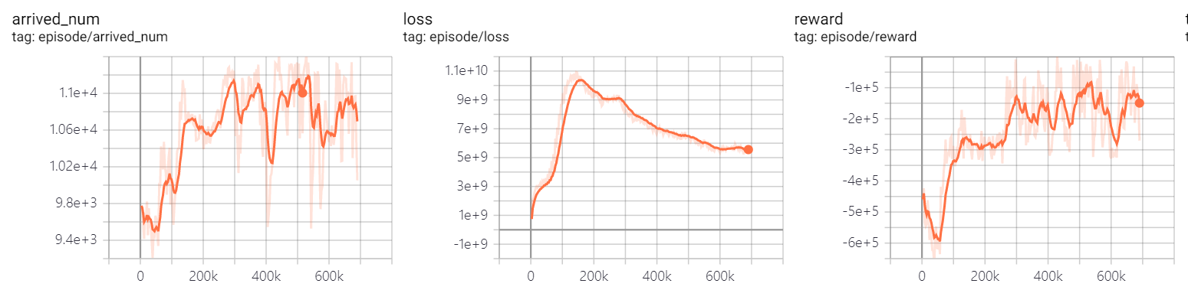
Comparison between Simulation & Decentralized Agents
Simulation 0.133 (left, right), 0.388 (up, down), phase 20(G), 3(y)
The number of arrived number: 9474 (no via), 9765(via)
Experiment(Decentralized Agents Model)
The number of avg arrived number: 10600(no via, blue), 10800 (via, orange)
10~11% Increase

Slide 6
3x3Grid Decentralized Model with Practical Restraints
Condition(seed fixed)
Random routing vehicle generation (period 0.8), scale 1.1 (by randomTrips.py)
9 Decentralized Agents(No offsets, Update Asynchronously)
4 Phases(Vertical/Horizontal straight and left) 37s each, followed by all yellow 3s
Model applied min/max duration(28s,49s) and phase period(160s)
State
The number of inflow vehicles from each inflow edge(left, straight)
Update current phase demand info from end of current phase

Slide 7
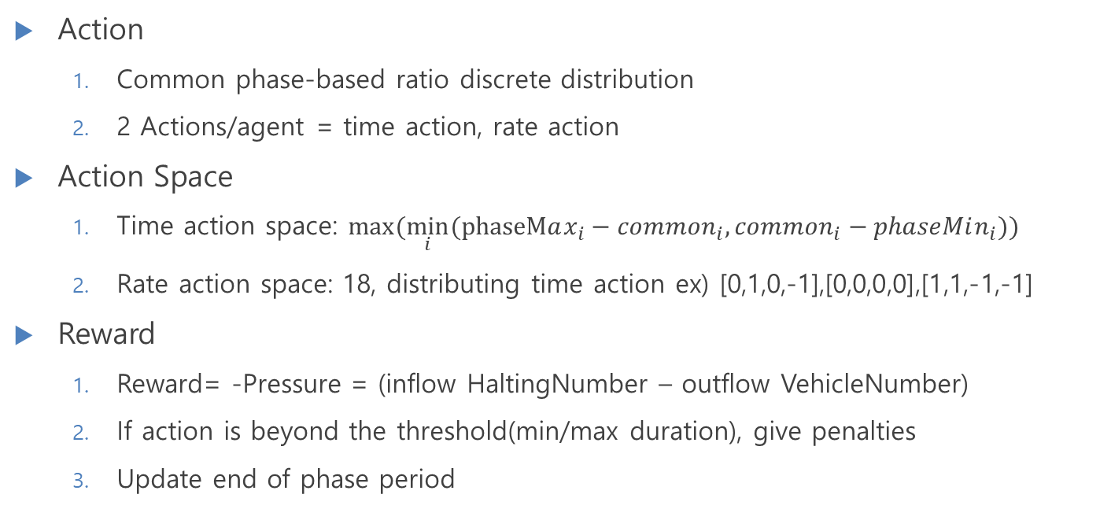
3x3Grid Decentralized Model with Practical Restraints
Action
Common phase-based ratio discrete distribution
2 Actions/agent = time action, rate action
Action Space
Time action space: $max⁡(\min_{i}⁡(phaseMax_{i}−common_{i},common_{i}−phaseMin_{i}))$
Rate action space: 18, distributing time action ex) [0,1,0,-1],[0,0,0,0],[1,1,-1,-1]
Reward
Reward= -Pressure = (inflow HaltingNumber – outflow VehicleNumber)
If action is beyond the threshold(min/max duration), give penalties
Update end of phase period

Slide 8
3x3Grid Decentralized Model with Practical Restraints

